Slide 1
RDBMS Design For
a P2P Lending Platform
Jia Yang
Penglin Du Xinrui Dong Suzy Gao Yumeng Gu

Slide 2
The peer-to-peer(P2P) lending marketplace works through a simple online platform, which connects borrowers and lenders.

Slide 3
Normalization Procedure
Dataset Source:
Prosper client data
Row data
Separate non-atomic values
The dataset has a rich records of 81 variables and 113,979 observation for each loan list data from 2005 to 2014, which are suitable for a database design.
1NF
Remove
Partial Dependency
2NF
Remove Transitive Dependency
3NF

Slide 4
ER Diagram
Investor
Borrower

Slide 5
ETL Process
Peer-to-peer Loan Data Management System
1. Data Cleaning: convert data types;
2. Splitting: 'separate_row';
3. Deduplication: create unique identifiers;
4. Format Reversion: unit or measurement, date & time;
Data Source
Investor Data
Prosper Loan Data
Extract
Transform
Borrower Data
Randomly Generated Data
Load
Loan Fulfillment and Repayment
10-Year Treasury Constant Maturity Rate
Extract, Transform and Loan (ETL)

Slide 6
Analytical Procedure
Average investment limit for investors in different aging ranges
Cities of most numbers of investors
Number of investors for each payment bank
Borrowers with highest/lowest monthly income
Average loan amount vs Occupation
Reason for loan vs Delinquent
Gap between monthly payment and loan amount
Credit rating scores → 8 levels, Income → 3 groups
Locations of most borrowers/highest borrower average monthly income

Slide 7
Analytical Procedure
A reliable RDMS contains comprehensive industry data
Customers’ needs that we design for
Interactive dashboard which can automatically update when new data is stored
Data analytics and visualization which are understandable for non-technology people
Customer portal of Borrower and Investor
What insights are our customer looking for
Risk assessment of lender and lending transaction
Healthy and sustainability in cash flow operation
Notes:
http://s19db.apan5310.com:3201/public/dashboard/ee8a48c2-7d83-4229-ba12-619efa7586ce

Slide 8
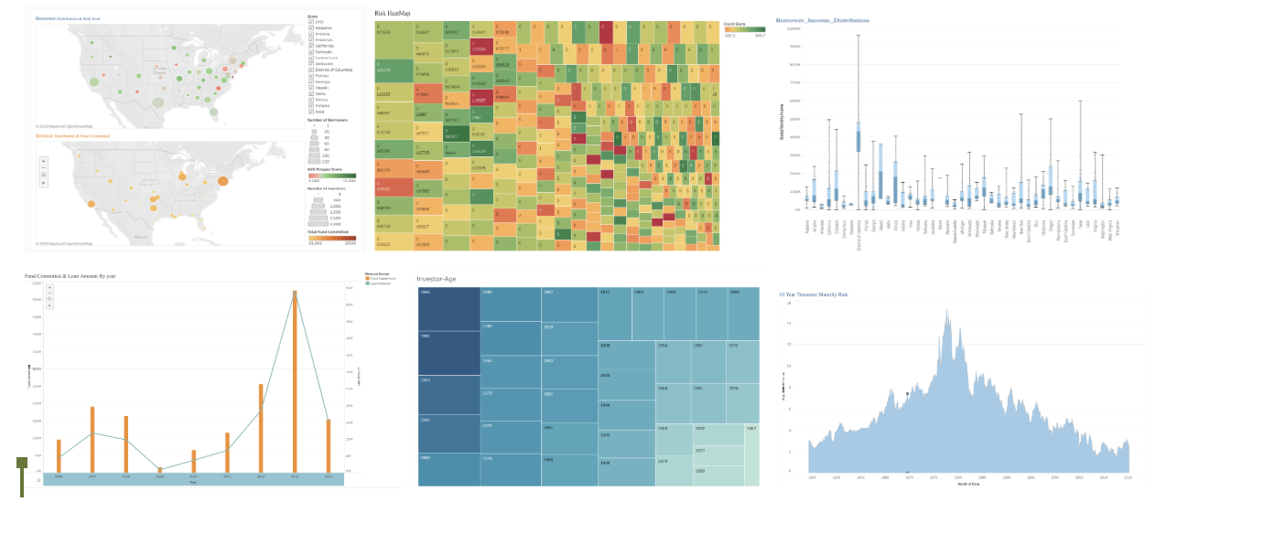
Dashboard
Notes:
we also use tableau to build another dashboard.
In tableau, we created 6 figures.
Figure 1 shows the distribution of borrowers and investors and cash flow. Size means the number of clients. in the borrower graphic, the darkness of the Color means amount of loan. In the investor graphics, darkness means the amount of fund we received. With the tool bar on the side we can see the information of selected regions
Figure 2 shows the loan and risk information of borrower who have most loan, the larger size means the most loan they have.
Red means lower credit score and green means higher credit score. We can see their id ,number and amount of delinquency, Credit score, loan rate.
With the toolbar, we can filter the information of select groups such as credit score below 700, or clients with at least 1 delinqucy . We can also find the specific client information by inputting their id.
With these dashboard, Prosper can find out the borrowers with high default risk and take actions to mitigate that risk.
we also have income analysis, age distribution, and 10y treasure maturity rate , which is an important index for loan business.
In this dashboard,
demographic information help Prosper to make better marketing strategy.
The risk metrics help Prosper to measure and monitor the risk of their loans.
Our dashboard focus on two kinds of information: demographic and risk-related
information of borrowers and investors.
Figure 1 shows the distribution of our borrowers in different states and their average
credit score. Another part of Figure 1 shows the distribution of our investors and the
fund they invest.
Figure 2 demonstrates a variety of risk metrics of the users who borrow more than
$100,000 in Prosper. The risk metrics include credit score, number of delinquents,
amount of delinquent and borrow apr.
Figure 3 shows the income condition of our borrowers, which is an important financial
metrics to know our customers
Figure 4 shows the capital flow of Prosper. The bar chart means the inflow of capital
from investors while the blue line shows the outflow of the loan amount to our
borrowers. This We know the balance of our cash every year.
Figure 5 shows the age distribution of our borrowers, which could help us know the
demographic information of our borrowers.
https://public.tableau.com/profile/jia.yang#!/

Slide 9
Design is not just what it looks and feels.
Design is how it works
Steve Jobs
Notes:
s

Slide 10
Q & A

